Slide 1
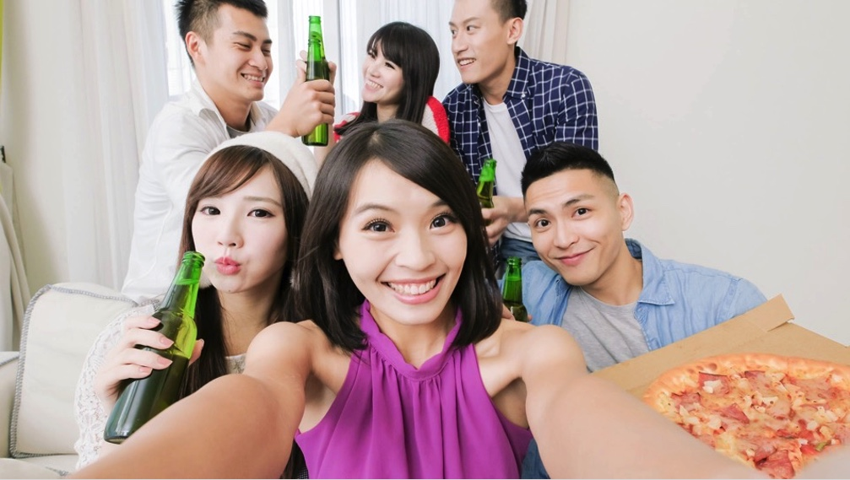
I'm an ESTJ
Extrovert

Slide 2
There's a saying:
Your clothes are your wings
but I think personality is more important.
My professor says that life is a sales contest,
and the product you sell is yourself.

Slide 3
I'm
a Joiner
an Outdoors Person
a Weekend Warrior
Here's proof:

Slide 4
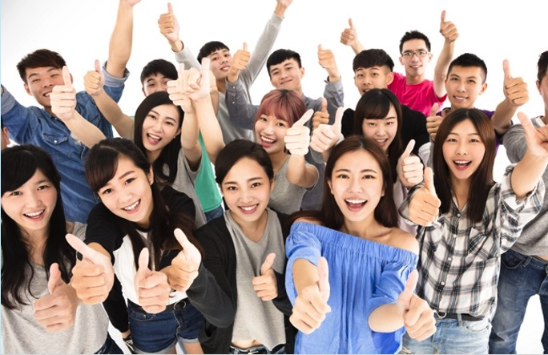
1 Joiner

Slide 5
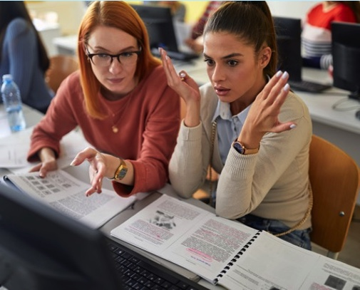
Computer Club
This is my favorite club, because of the:
Members
Technology
Computer Animation
Advisor professor

Slide 6
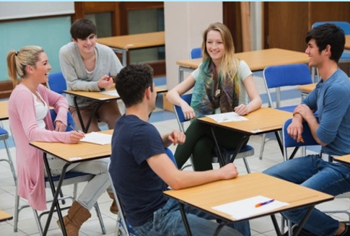
English Club
We meet every Friday after class.
There are about 20 members.
Many different majors. Mostly 1st, 2nd, and 3rd year, but only 3 or 4 seniors.
Our club room is in the media building because we watch a lot of English movies.

Slide 7
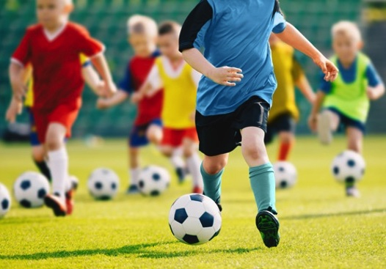
Volunteer coach
The soccer team that I help coach has Koreans and the children of foreign professors.
We practice every Saturday morning at their school.
We try to speak only in English, and it's a good cultural exchange.

Slide 8
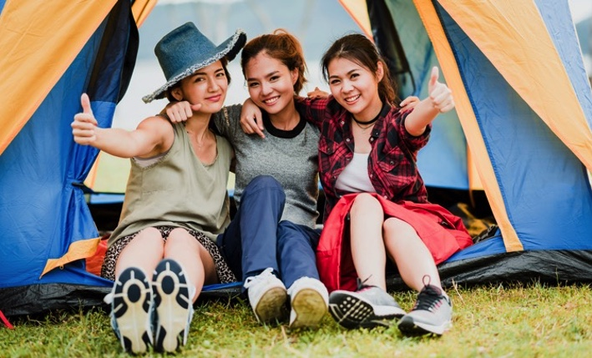
2 Outdoor person

Slide 9
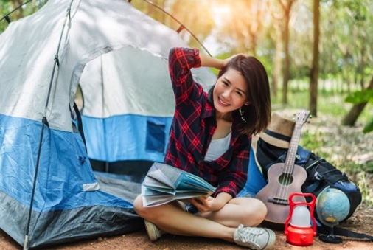
Camping
My father is the outdoors type. He was in special forces in the army, and knows all about the outdoors.
I like camping because outside of the city you can see so many stars.

Slide 10
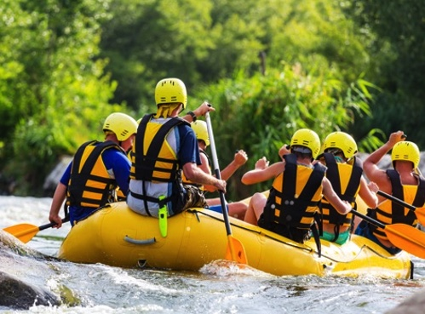
White water rafting
Some people are scared of the water, but not me.
I like the water and the added danger of white water.
We usually go near Cheunchon. It's easy access, and the rafting company has everything.

Slide 11
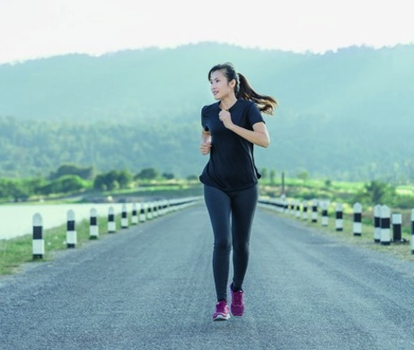
Jogging
I was on the track team in high school and so I was in great shape.
That's when I started jogging. I jog about 10 miles a week, on Tuesday and Thursday morning.
For me, jogging is like meditation, an I get to sightsee. I like jogging because it relieves stress.

Slide 12
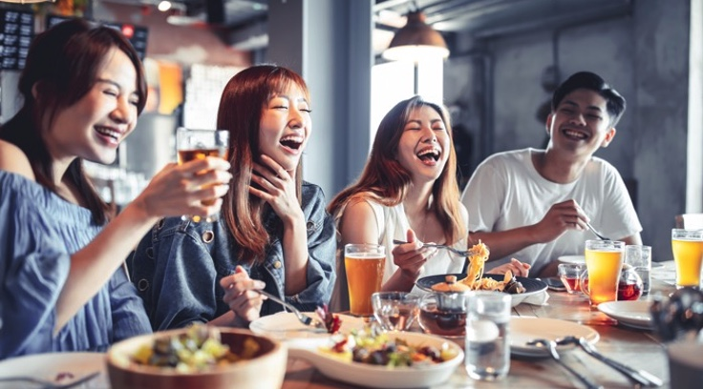
3 Weekend Warrior

Slide 13
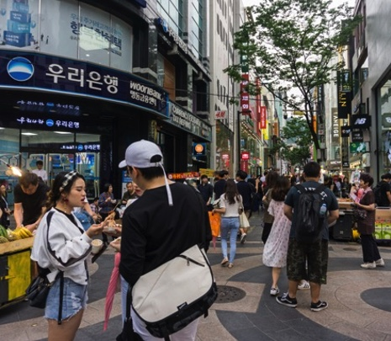
Friday after class
After class we have our English club meeting, then I meet my boyfriend in Myongdong.
We walk around and eat food on a stick, and watch the street performers.
I usually take the last subway home.

Slide 14
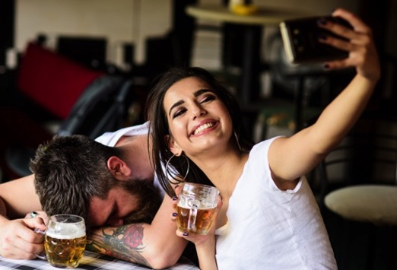
Saturday night
Saturday night is couple night, quality time with my boyfriend.
We go to BHC and get beer by the pitcher.
They have a big screen TV and show soccer games or Korean girl group videos, like Blackpink.

Slide 15
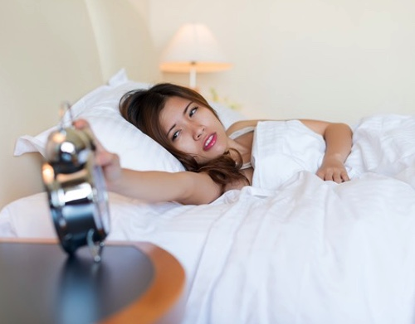
Sunday morning
I party late so I sleep late. My parents got to church so I have the whole house to myself.
After lunch I meet my boyfriend at we go walking along the Han River.
Sunday night I cram get ready for the next week.

Slide 16
Conclusion

Slide 17
I'm a people person. I belong to three clubs and I'm the president of two.
My whole family loves the outdoors, especially my father. He's a real country boy and I got my love of the outdoors from him.
I'm a social butterfly. On the weekends I'm always on the go. 24-7. I'm spontaneous.

Slide 18
Thus, I'm
a Joiner
an Outdoors Person
a Weekend Warrior

Slide 19
I'm an
EXTROVERT

